Slide 1
choice in secondary pe
NYSAHPERD 2023

Slide 2
presenters
Chris Corey
Director of Physical Education & Health
Rochester City School District
Past-President, Section V Athletics
Henry Kuperus
PK-12 Physical Education Dept Chair
Varsity Boys Basketball & Golf Coach
Newark Central School District
Dave Seither
Physical Education Teacher
Varsity Boys Swim Coach
Gananda Central School District

Slide 3
Considerations for choice in pe
Team Games Dilemma
Who’s the expert?
Exposure vs. Enjoyment
What does ELA/Math do?
Whose responsibility is engagement?
High Quality Physical Education
Notes:
Exposure to team games is high
Physical Education
Media
Professional/Collegiate Sports
Exposure vs. Enjoyment
Even within team games, some kids are resistant
“Soccer is stupid”
“I just want to play basketball”
High Quality Physical Education
Cannot be ‘roll out the ball

Slide 4
Gananda high school
9-12 High School
70-90 Graduates (Class C)
93% Graduation Rate
Rural/Suburban
31% Economically Disadvantaged
13% Racial & Ethnic Minority

Slide 5
Gananda high school
Co-Ed PE Classes
Generally 9/10 & 11/12
Several Examples of 10-12 or 9-11
Meeting Pattern
Every other day for 60 minutes!
Changed to every fourth day for 84 minutes

Slide 6
Class structure
1-3 Teachers
20-25 students per teacher
Six (6) Marking Periods
Six (6) weeks per marking period
Three weeks per unit

Slide 7
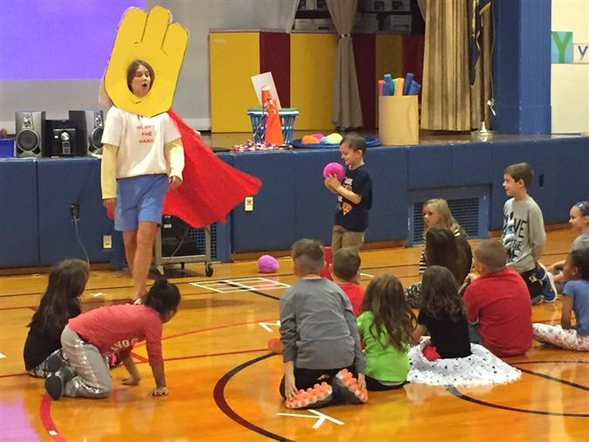
How to choose?
Change class rosters every three weeks
We knew ALL freshmen
Present options
Flag Football/Geocaching/Fitness
Students line up in order and choose
First set of options: Start with last name starting G…go through H
Second set of options: Start with H…. Go backwards through G
Base on Activity
Not teacher or peers

Slide 8
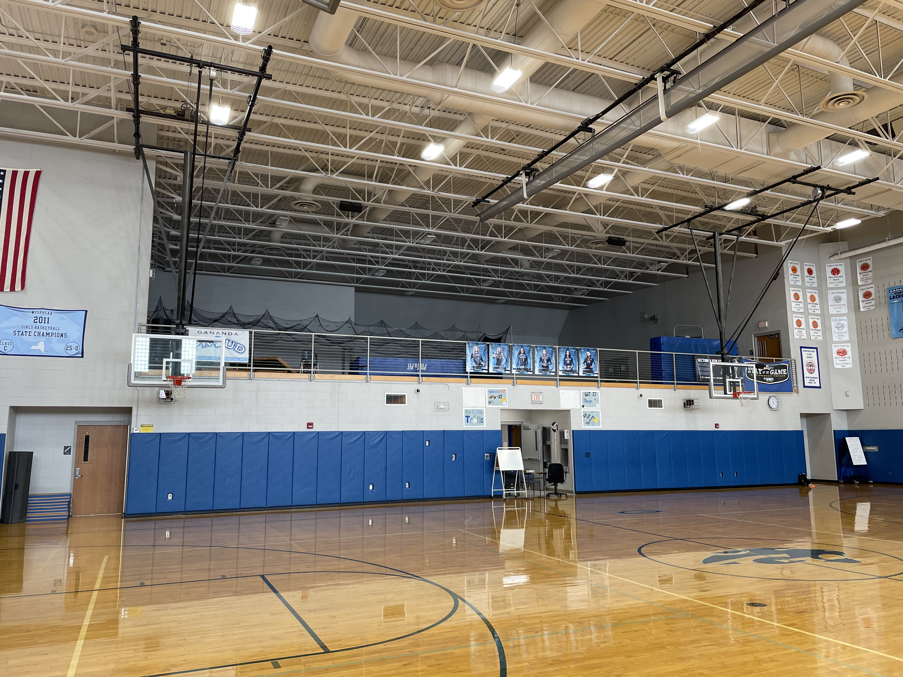
GYMNASIUM
Notes:
Good size, small school gym - With a curtain - 10 feet short on each side but certainly doable

Slide 9
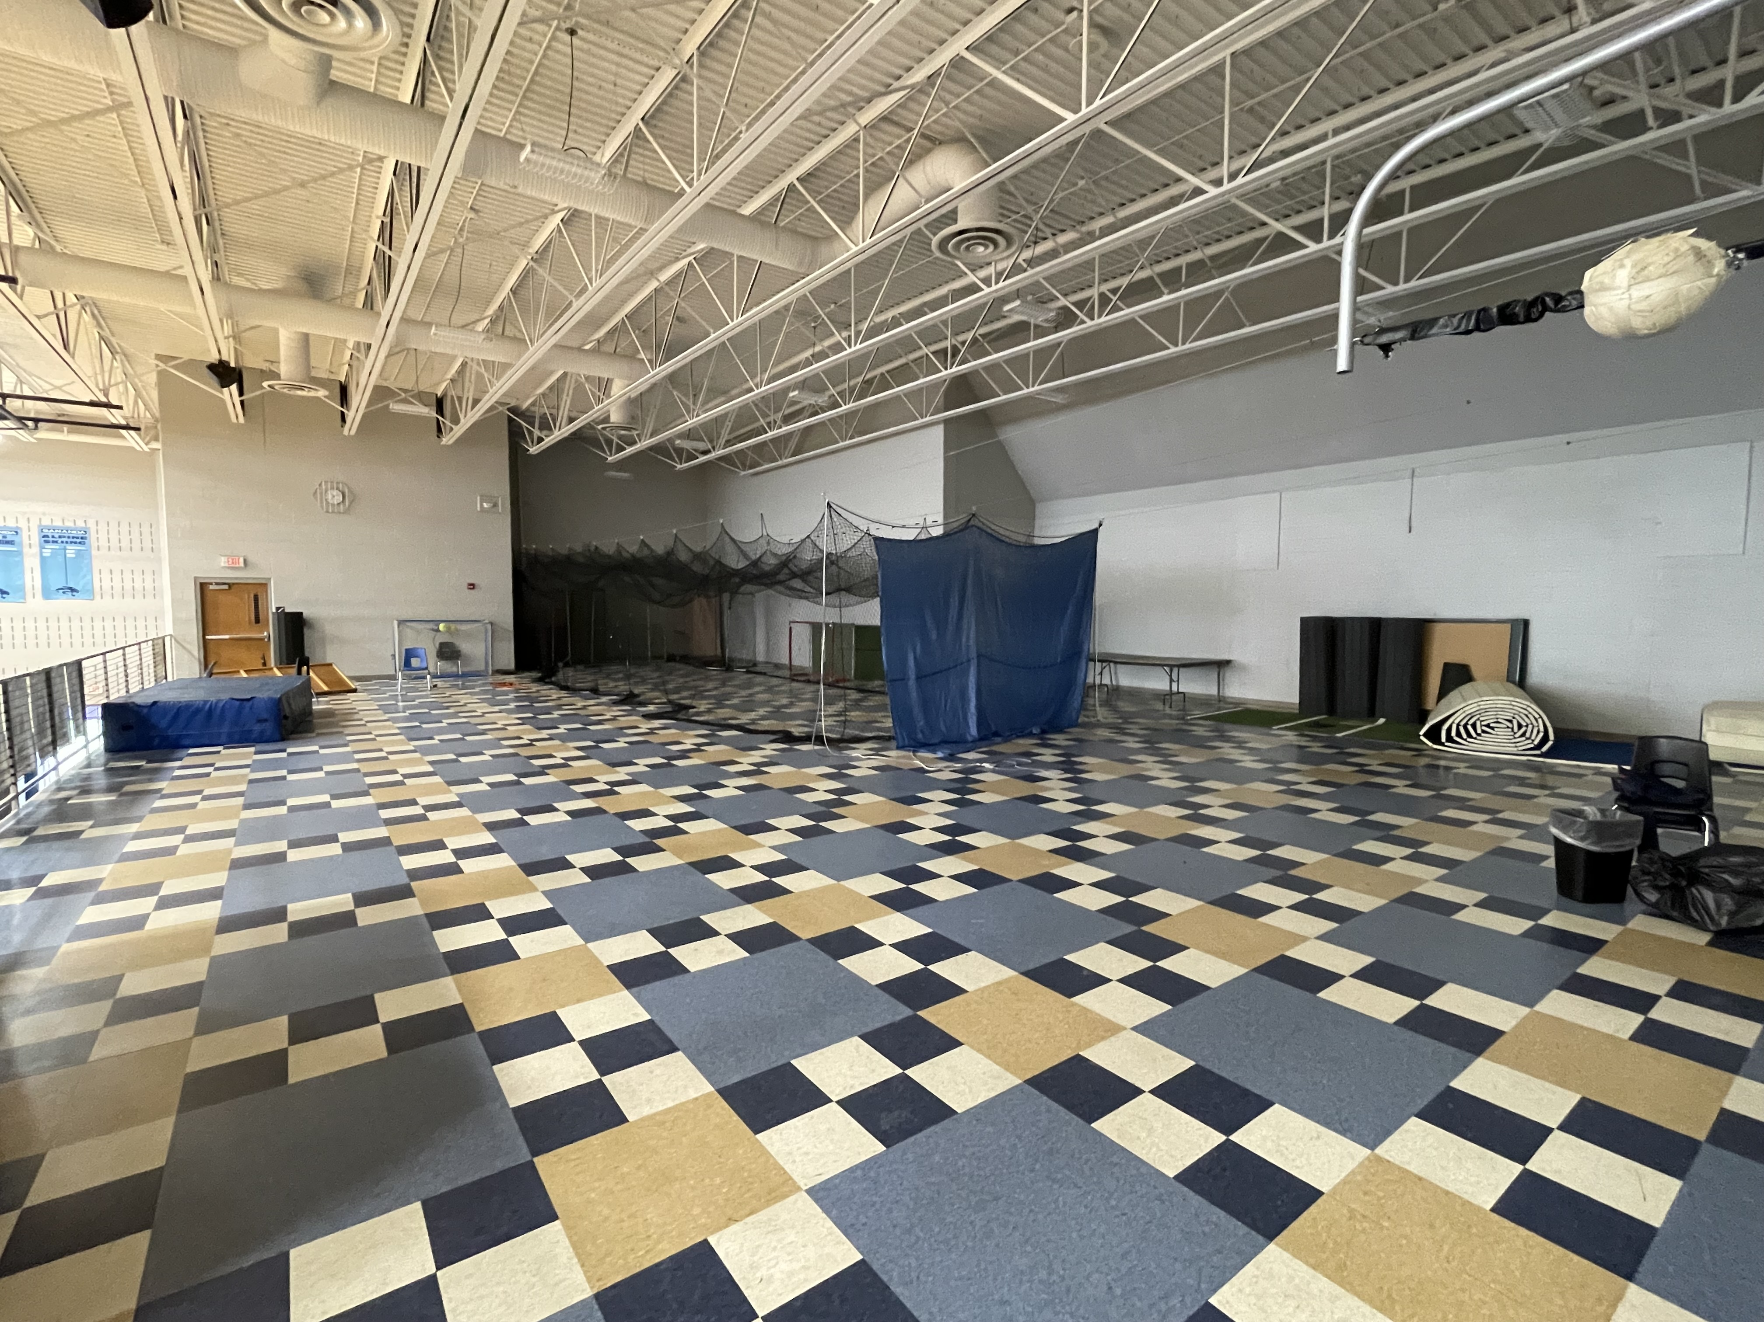
BALCONY
Notes:
Unique Balcony space - Batting cage - Enough space to move - no large sided games - amazing station area

Slide 10
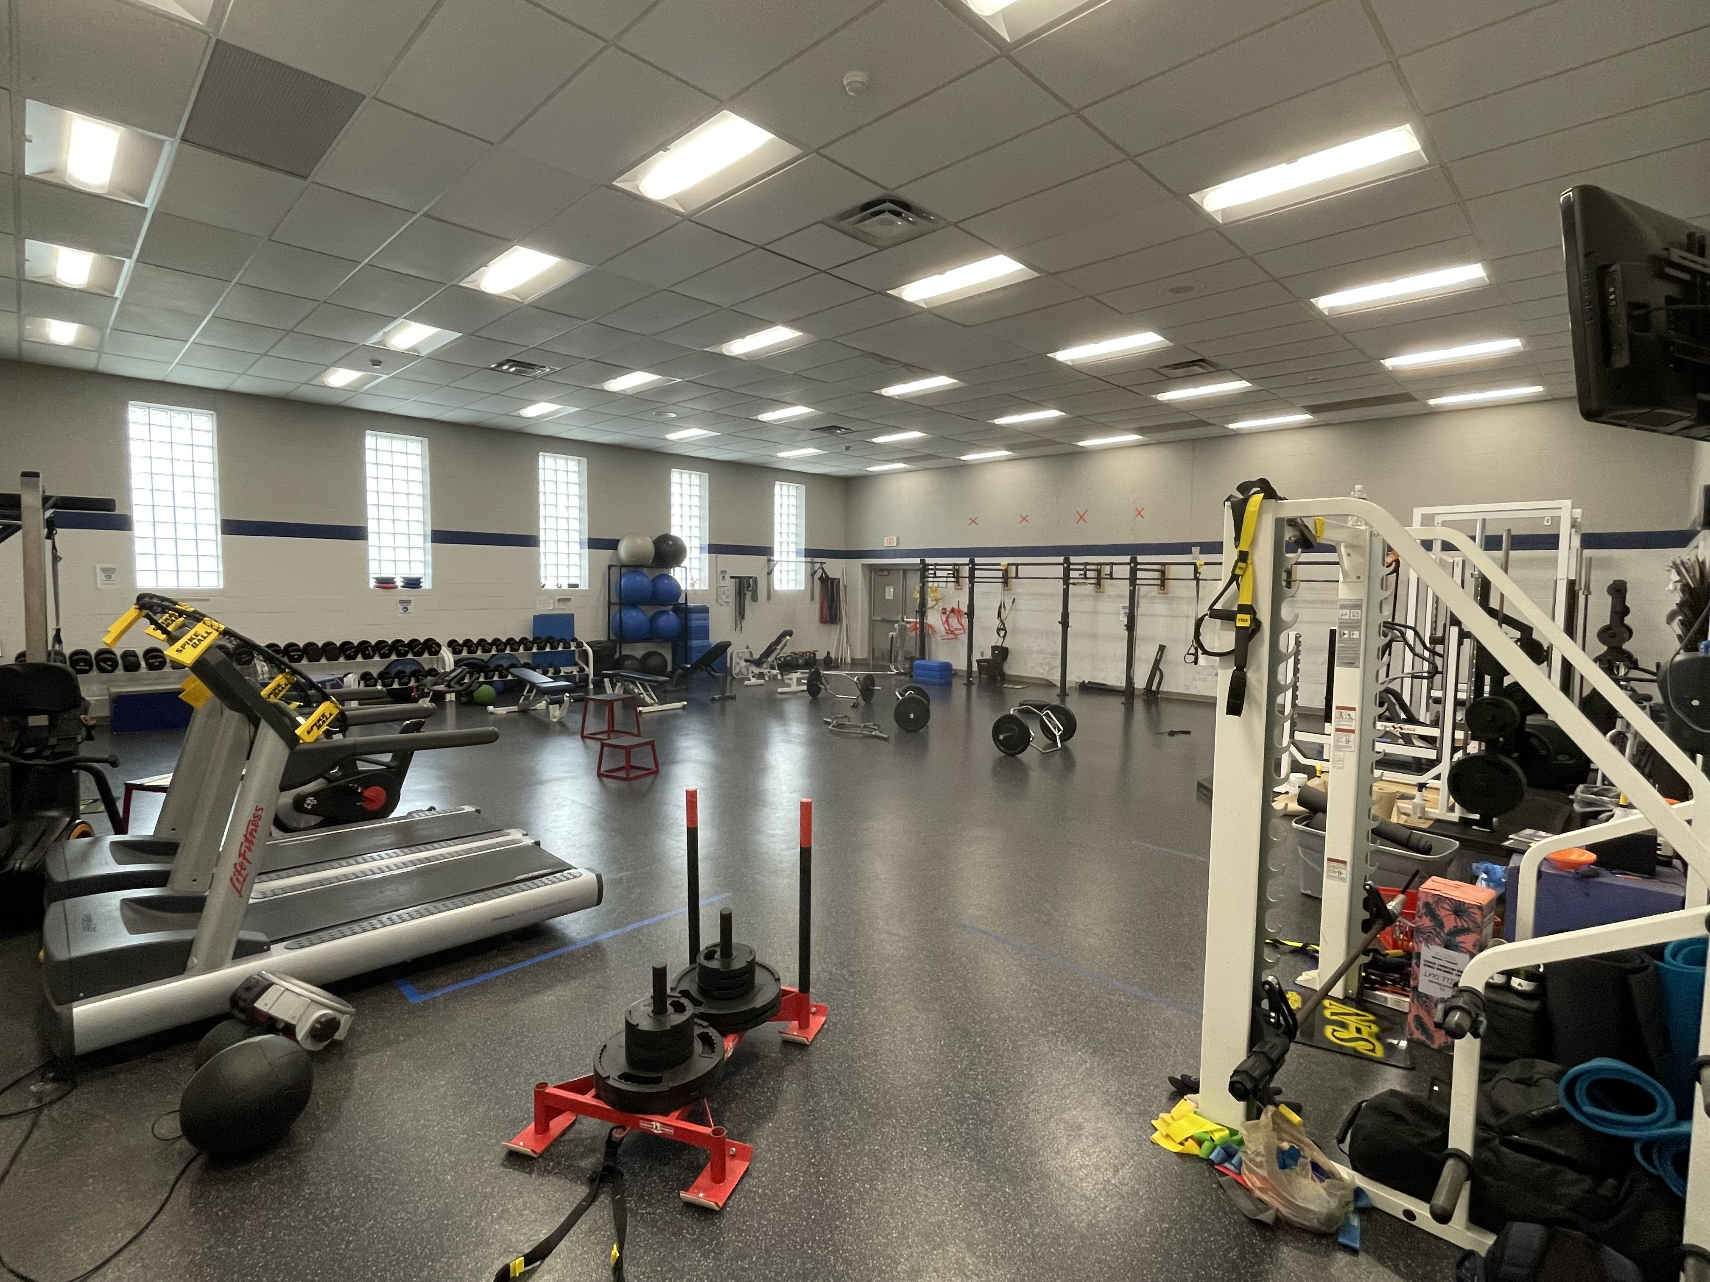
FITNESS
CENTER
Notes:
Big enough for a full section of students

Slide 11
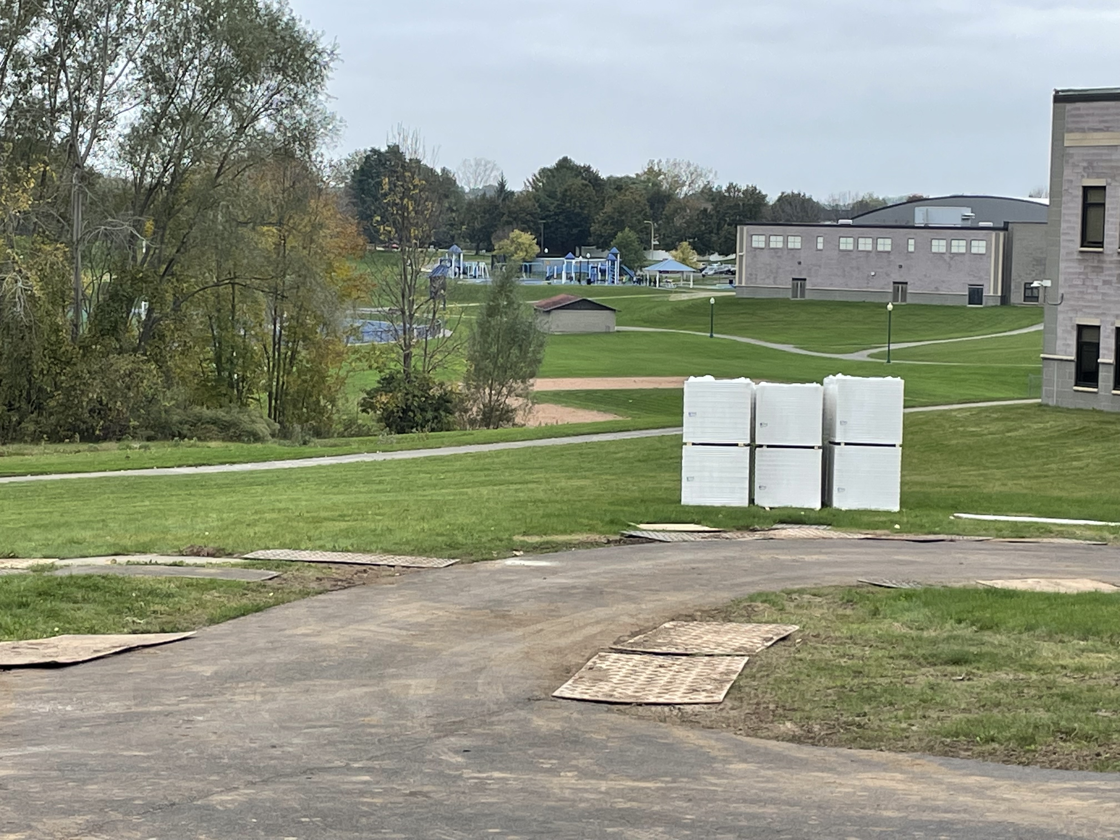
OUTDOOR
Notes:
Rolling Hills - Baseball Field - Walking trail around campus - Soccer Field a ways away

Slide 12
Principal buy-in
Master Scheduling
Engagement & Achievement
Choice
Readiness and Interest
Health & Well-Being
But really engagement ☺
Notes:
Engagement is the key – Students→ Motivated by choice
Staff → Motivated by opportunity, not the same old same old
Kids who want to PLAY GAMES and complain about hiking, play games
Kids who want to HIKE and not perform in front of their peers, do that

Slide 13
Master scheduling - gananda
Must produce flexibility
Could not do different sections
Need multiple teachers on at same time
Age-Appropriate Mixings
Avoid 9th and 12th graders

Slide 14
Non-negotiables
Swimming
Dance
Personal Fitness
Weightlifting

Slide 15
Newark high school
9-12 High School
24% Racial & Ethnic Minority
140-160 Graduates
89% Graduation Rate
Rural/Urban
52% Economically Disadvanted

Slide 16
Class Structure
THEN
NOW
By Gender
9/10 & 11/12
Every other – 44m
Co-ed
9 & 10-12
Every other – 42m

Slide 17
Unit rotation – pre-choice
 | Teacher 1 | Teacher 2 | Teacher 3
Weeks 1-3 | Golf | Tennis | Soccer
Weeks 4-6 | Tennis | Soccer | Golf
Weeks 7-10 | Soccer | Golf | Tennis
Notes:
Same curriculum through 4 years
Kids would stay with assigned “teacher of record”

Slide 18
Choice!
10th-12 Grade - Coed
9th Grade - Coed
Adventure
Team Games
Lifetime/Individual
Lifeguarding
Mix
Unified PE
Coaching & Officiating
Scripted
Follows ‘Mix’
Commencement Level
Basic Swimming

Slide 19
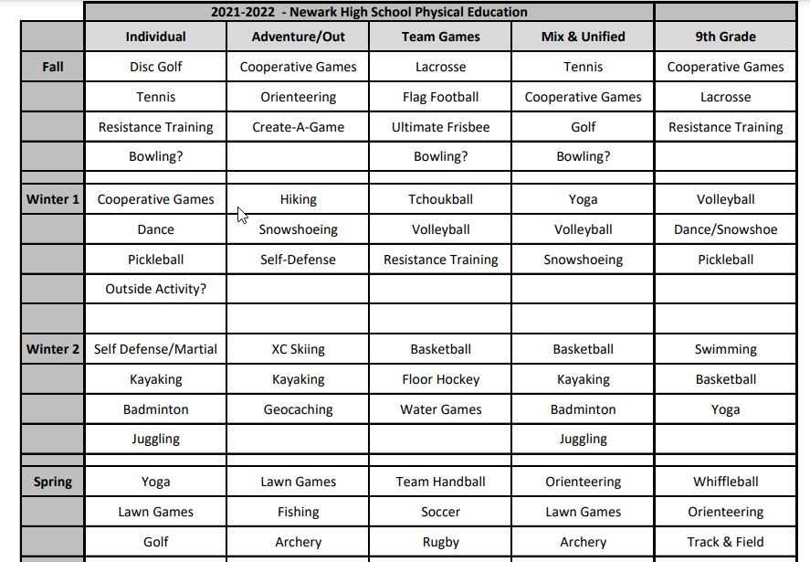

Slide 20
Survey

Slide 21
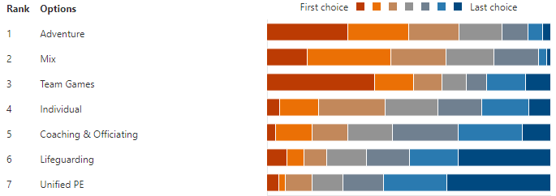
Notes:
Most first place choices are not the favorite.
Most telling… what kids DO NOT want.
Look at Unified PE, Lifeguarding
More kids want TEAM GAMES but more kids DO NOT WANT Team Games than Adventure/Mix

Slide 22
Scheduling students (counseling)
Survey Results
Provide counseling with top two choices of each student
Provides Flexibility
Back and forth
If top two don’t fit, provide third
Year 1 – 12/650 students did not get top 3
Called them…. Most said “oh ya, that’s fine”
Notes:
Could provide them with top three and bottom 2

Slide 23
Master scheduling
NO Singletons!
15:1, AP CHEM, Advanced Russian Literature II
Must produce flexibility
Could not do different sections
Need Multiple Sections of Each Choice
Age-Appropriate Mixings
Avoid 9th with 12th

Slide 24
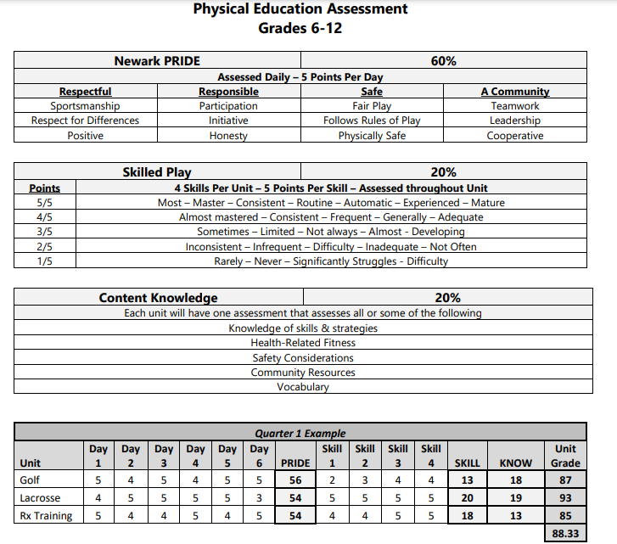
COMMON
RUBRIC

Slide 25
Six-day units
180 Days per school year
90 Days of PE
4 Marking Periods
22 Days of PE per Marking Period
Three (3) Six-Day Units
18 Total Days
4 Extra Days per Marking Period
Base Games!
Juggling
Bowling
Counseling
Surveys (PE, English, Social Studies)

Slide 26
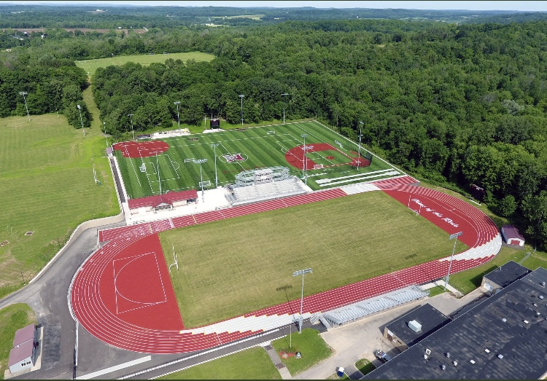

Slide 27
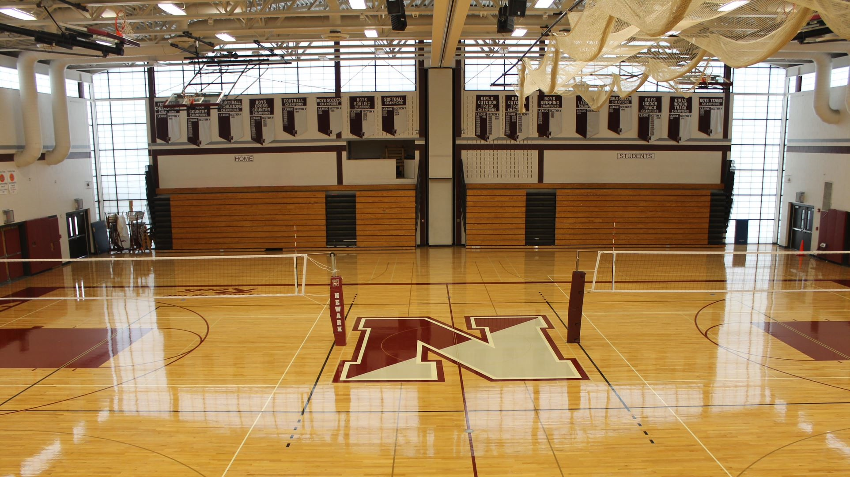
GYMNASIUM

Slide 28
Non-negotiables
Swimming
Dance
Personal Fitness
Weightlifting

Slide 29
Better for teachers too!
Teacher 1
Football & Baseball Coach
Loves team games, in’s & out’s, x’s/o’s
Favorite class = Adapted
Teacher 2
Football, Girls Bball, Lacrosse Coach
Loves Adventure
Swimming Background
Team Games is boring
Teacher 3
Big picture of Physical Literacy
Identifies with students who struggle
Engagement = Priority #1
Notes:
Strengths, Weaknesses, Interests
“Change it up”
Managerial Right… might think one is a better fit

Slide 30
Considerations for assignments
Strengths & Weaknesses
Interests
Number of Preps
“Change it Up”
Building Culture
Schedule Format

Slide 31
Bigger picture – advocacy
Profession has not done ourselves any favors
Modern, progressive, high-quality PE!
Physical Literacy!
Principals, Counselors, Directors, Supers, BO
Planned, sequential, rigorous
Learning not Recess

Slide 32
Questions?
Contact Info
Christopher.Corey@rcsdk12.org

